Slide 1
Introductory General Chemistry
Chemistry 3A
S. M. Halloran

Slide 2
Word Equations
Chemical Equations
Balancing Equations
Predicting Reactions: Single & Double Displacement Reactions
Writing Chemical Equations for Reactions in Solution
Complete Chemical Equations
Complete Ionic Equations
Net Ionic Equations
Oxidation/Reduction
How to understand them and to apply them

Slide 3
Word Equations

Slide 4
Chemical Equations

Slide 5
Balancing Equations

Slide 6
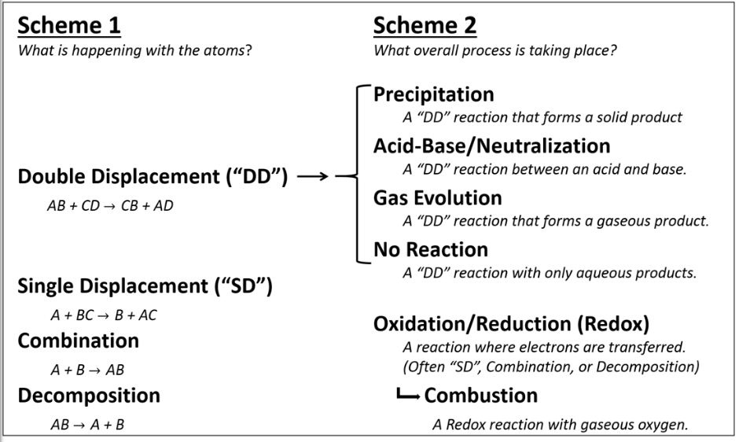
Types of Reactions

Slide 7
Decomposition Reactions

Slide 8
Combustion Reactions

Slide 9
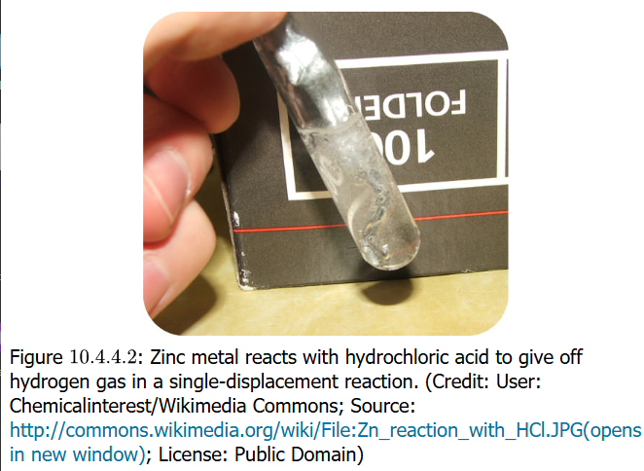
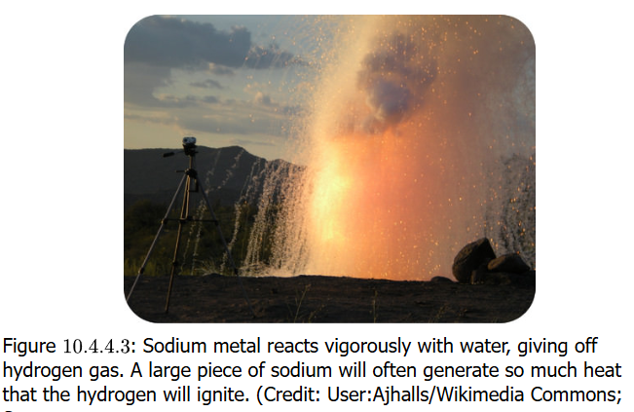
Single Displacement/Replacement Reactions

Slide 10
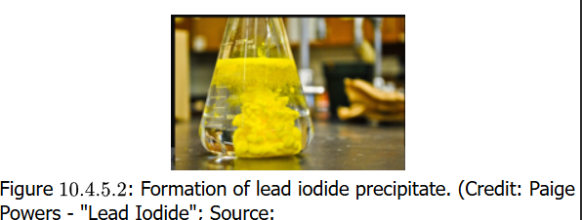
Double Displacement/Replacement Reactions

Slide 11
Predicting Single Displacement Reactions

Slide 12
Predicting Double Displacement Reactions

Slide 13
Precipitation Reactions

Slide 14
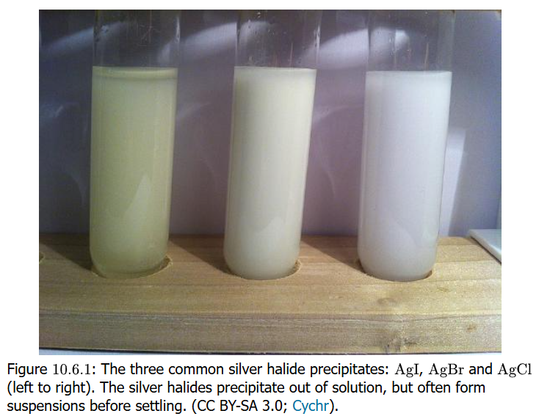

Writing Equations for Reactions

Slide 15
Oxidation States

Slide 16
Oxidation States & Redox Reactions

Slide 17
Half Reactions

Slide 18
Activity Series

